Slide 1


شركة منهاتن للوكالات التجارية
Notes:
Links:
https://www.pexels.com/photo/photo-of-people-holding-each-other-s-hands-3184423/

Slide 2


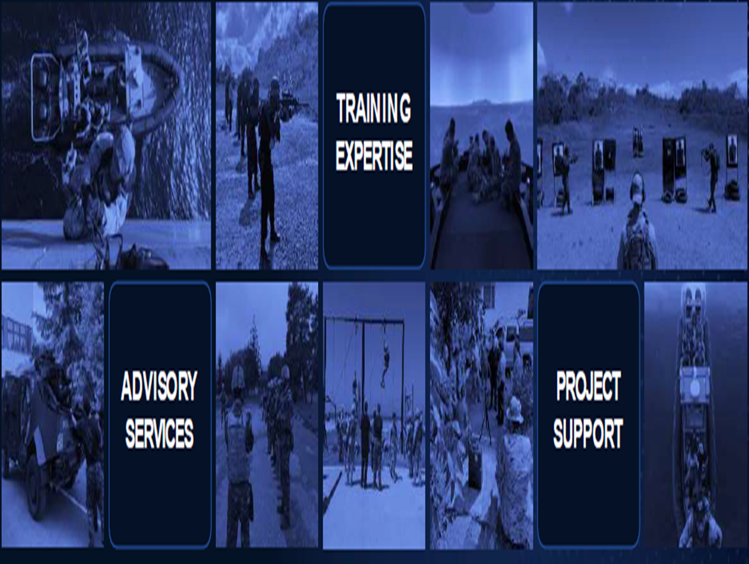

Middle east leader in supplying S.W.A.T Equipment and training
Notes:
Links:
https://www.pexels.com/photo/female-engineer-planning-dam-3862389/

Slide 3


Slide 4
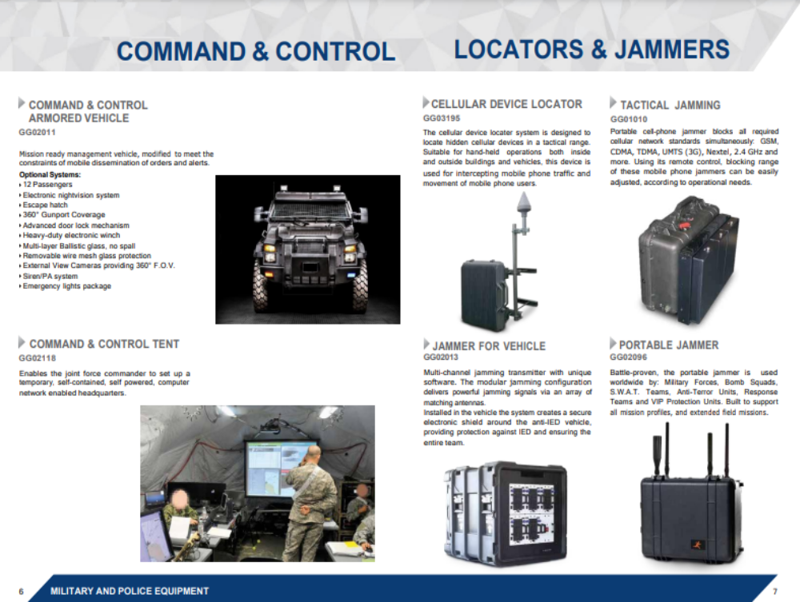

Slide 5
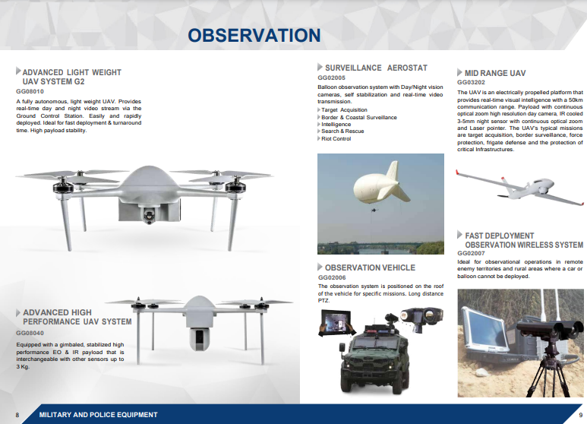


Slide 6
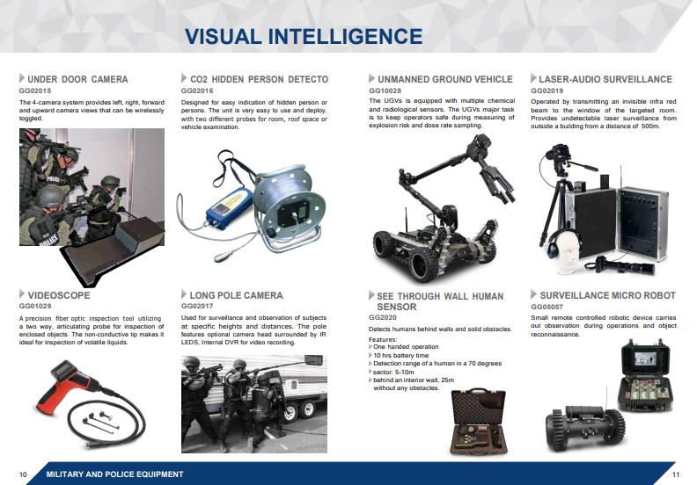
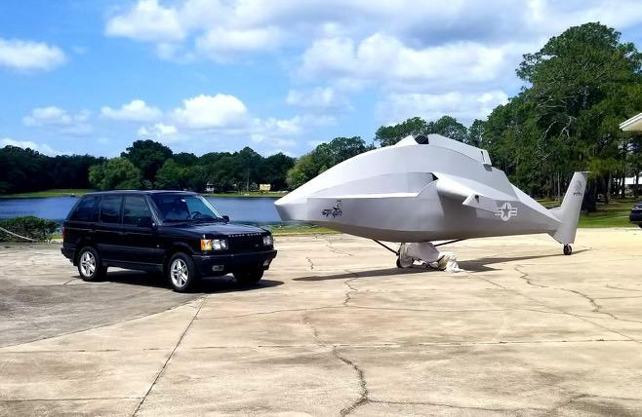

Slide 7
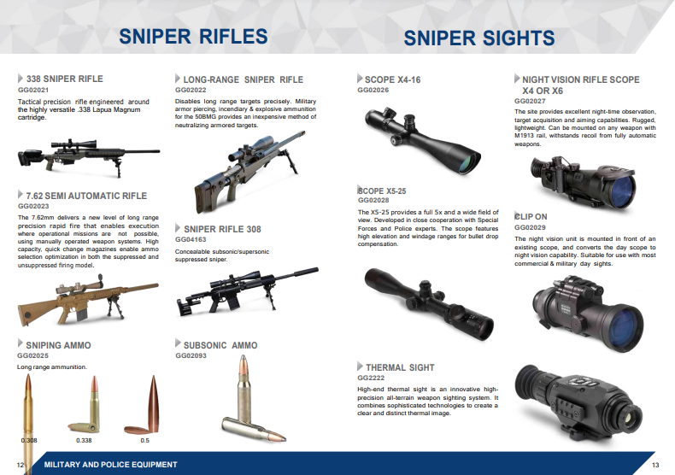

Slide 8
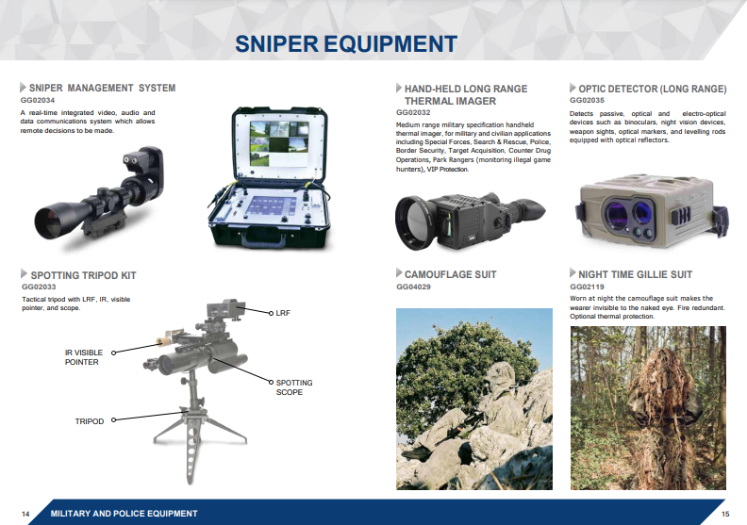

Slide 9
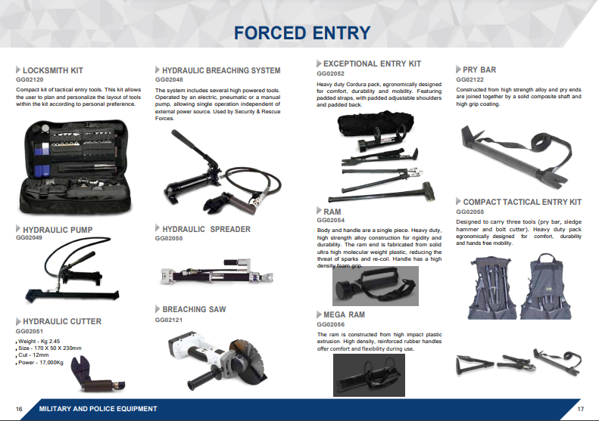

Slide 10


Slide 11


Slide 12
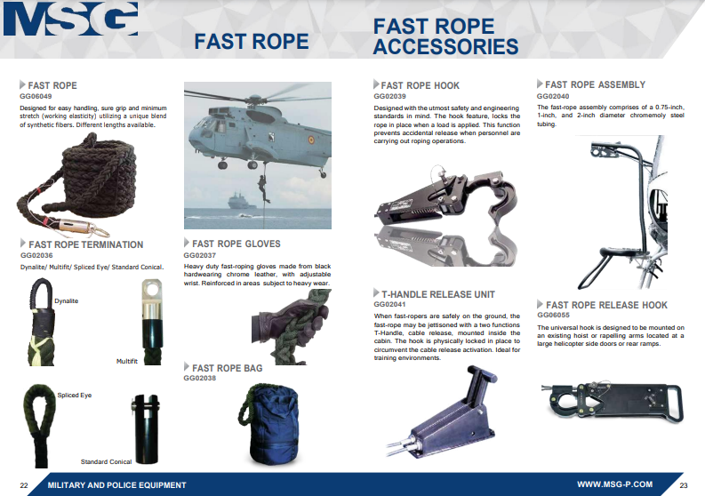


Slide 13
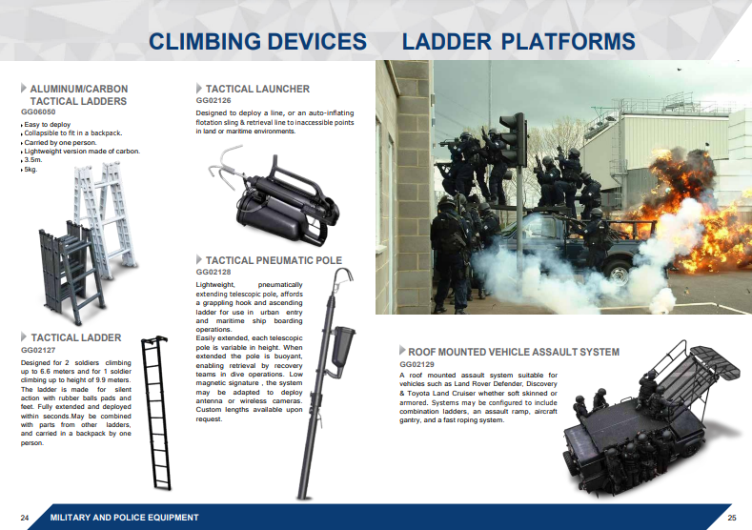

Slide 14


Slide 15
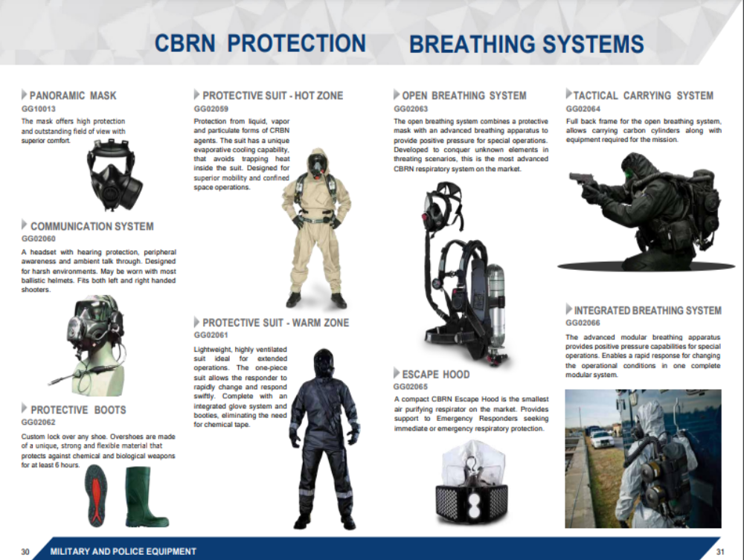

Slide 16
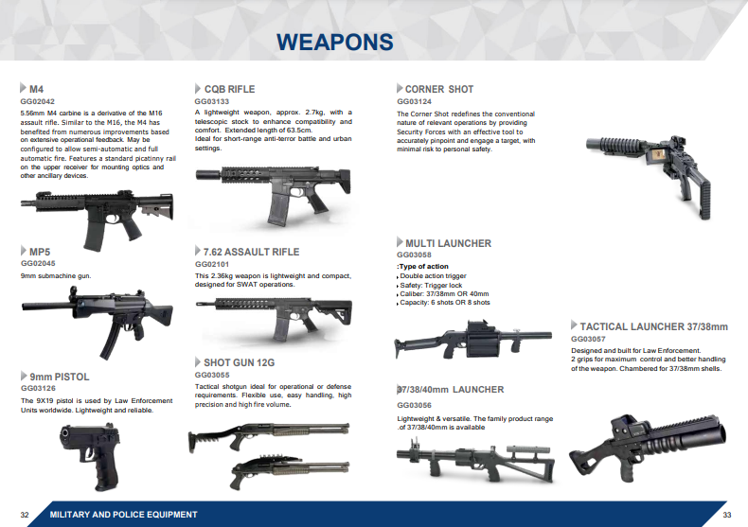

Slide 17
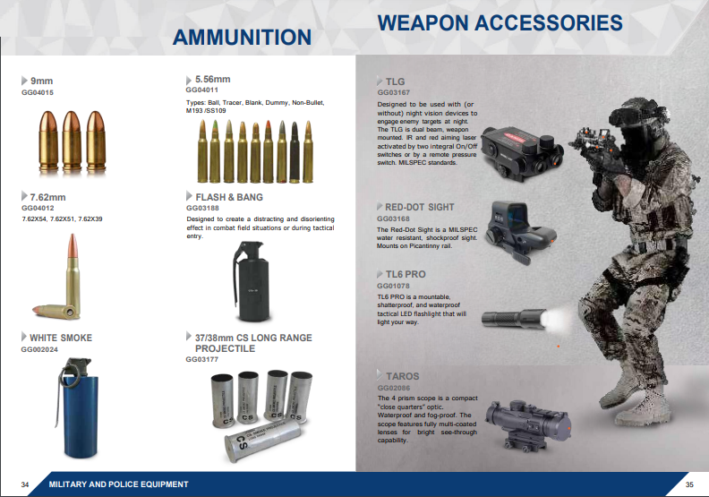

Slide 18
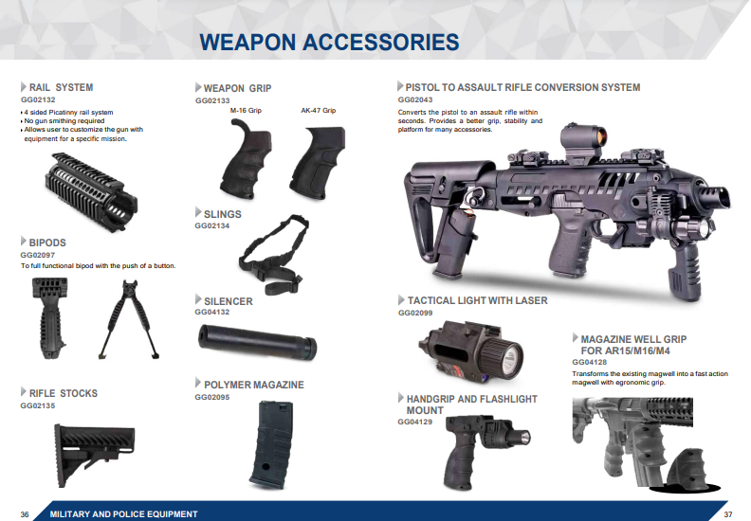

Slide 19


Slide 20
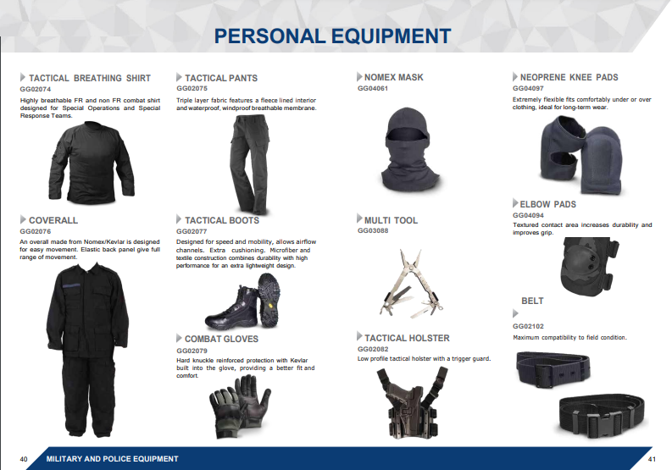

Slide 21
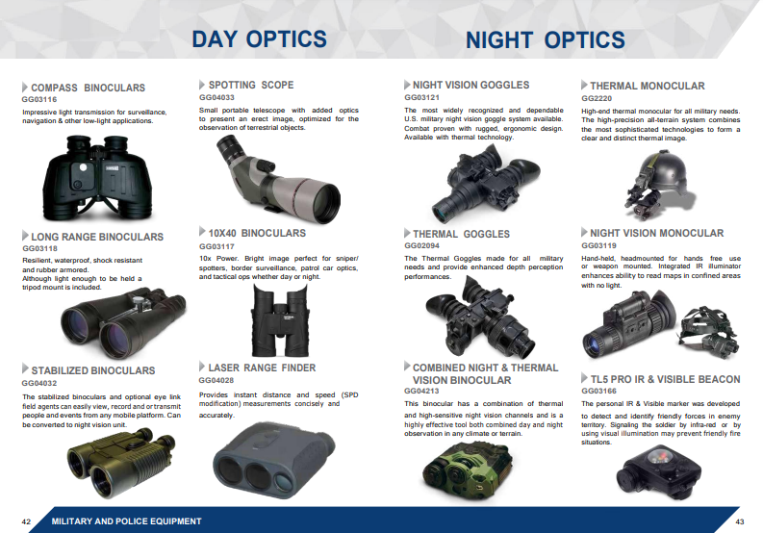

Slide 22
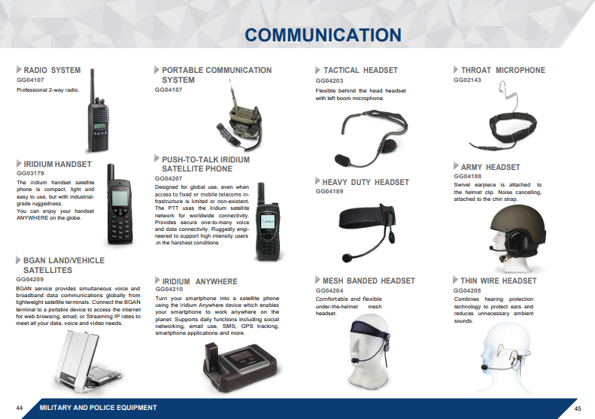

Slide 23
Security Assistance
We can work under FMF/FMS programs.
We can also work with national fund programs through our MENA Office in Jordan

